Slide 1

CAR DEKHO DATA ANALYSIS
Exploratory Data Analysis & Data Preprocessing
Done By : Atharva Abhay Deshpande
AICTE ID : STU6a5e292a5d1bd1784555818

Slide 2


PROBLEM STATEMENT
Used-car prices depend on several vehicle characteristics. Understanding which factors meaningfully influence resale value is non-trivial without structured analysis.
Key variables under investigation:
Vehicle age (model year)
Present showroom price
Kilometers driven
Fuel type & transmission
Used-car selling prices vary depending on factors such as vehicle age, present price, kilometers driven, fuel type, and transmission. This project aims to analyze Car Dekho data to understand these relationships and derive meaningful insights that can help understand used-car pricing.

Slide 3
PROJECT DESCRIPTION
Dataset at a Glance
Project Workflow
Source: Car Dekho Used-Car Dataset
Size: 301 rows × 9 columns
Type: Structured tabular data
1
Load & Understand
Identify and load the dataset; inspect structure, data types, and statistical summary
2
Data Quality Checks
9 Dataset Columns
Check for missing values, duplicate records, and inconsistencies
Car Name
Year
Selling Price
Present Price
Kms Driven
Fuel Type
Seller Type
Transmission
Owner
3
Outlier Handling
Detect outliers using boxplots for Selling Price, Present Price, and Kms Driven
4
EDA & Insights
Perform exploratory analysis and derive meaningful, evidence-based findings

Slide 4

WHO ARE THE END USERS?
Car Buyers
Car Sellers / Owners
Car Dealers
Can understand factors that influence used-car prices and compare vehicle characteristics before purchasing.
Can understand how factors such as car age, present price, fuel type and transmission relate to selling price, and get a better idea of resale value.
Can use the observed pricing patterns to support used-car evaluation and pricing decisions.
Used-Car Market Analysts
Data Analysts / Students
Can use the analyzed data to understand trends and relationships in the used-car market.
Can use the project as an example of data cleaning, exploratory data analysis and visualization.

Slide 5
Technology Used
Python
Pandas & NumPy
Core programming language for all data loading, manipulation, analysis, and scripting tasks throughout the project.
Pandas for dataset loading, cleaning, grouping, and aggregation. NumPy for efficient numerical operations and array computations.
Matplotlib & Seaborn
Jupyter / Google Colab
Matplotlib for scatter plots and boxplots; Seaborn for higher-level EDA visualizations and exploratory statistical graphics.
Interactive notebook environment for writing, executing, and documenting the analysis in a reproducible, step-by-step format.

Slide 6
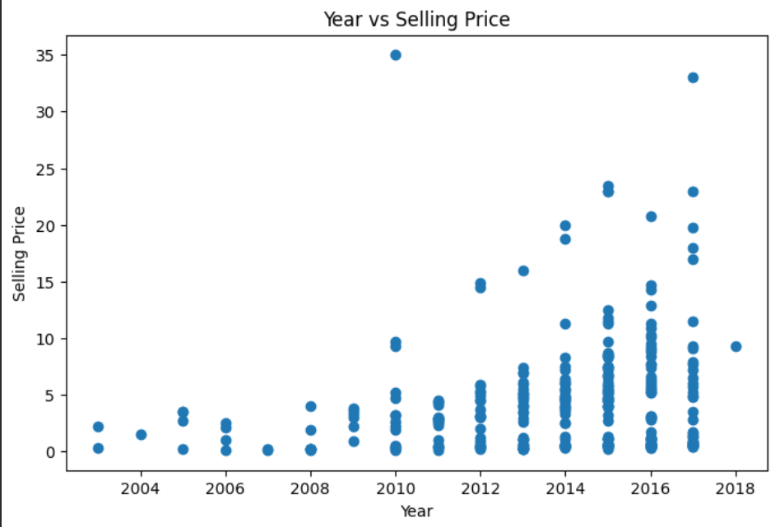

RESULTS
1. Car Year vs Selling Price
Observed Trend
Across model years 2016–2018, average selling price rises consistently as model year increases.
Year | Avg. Price (₹L)
2016 | 5.21
2017 | 6.21
2018 | 9.25
Interpretation
Newer vehicles command higher resale values in the dataset. Model year appears to be a meaningful differentiating variable for selling price.
Upward trend observed across selected years. No causal inference is drawn.
Demo Link : Click Here

Slide 7
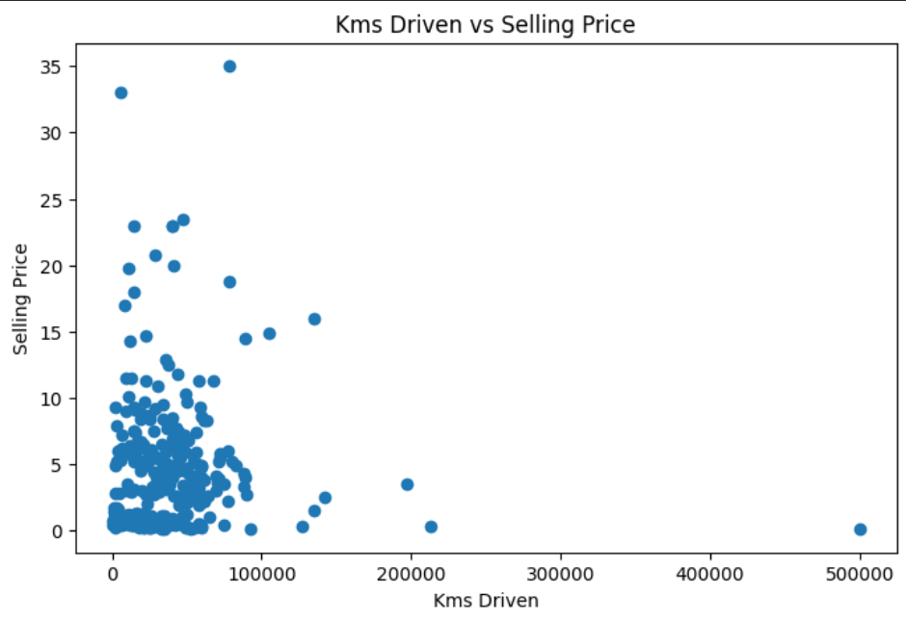
RESULTS
Correlation Coefficient
0.0292
Pearson correlation between Kms Driven and Selling Price
2. Kms Driven vs. Selling Price
Key Takeaway
What This Means
The near-zero correlation (r = 0.0292) suggests that higher odometer readings do not directly translate to lower selling prices — at least not through a simple linear pattern.
A value this close to zero indicates a very weak linear relationship. Kilometers driven alone does not reliably predict used-car selling price in this dataset.
Possible Explanation
Other factors — brand, model year, condition, fuel type — may overshadow raw kilometer counts when buyers assess value.
Analytical Caution
Correlation only measures linear association. A non-linear relationship may still exist and warrants further investigation.
Dataset Range
Kms Driven ranges from 500 to 500,000 — a very wide spread that may reduce the clarity of linear patterns.
Demo Link : Click Here

Slide 8
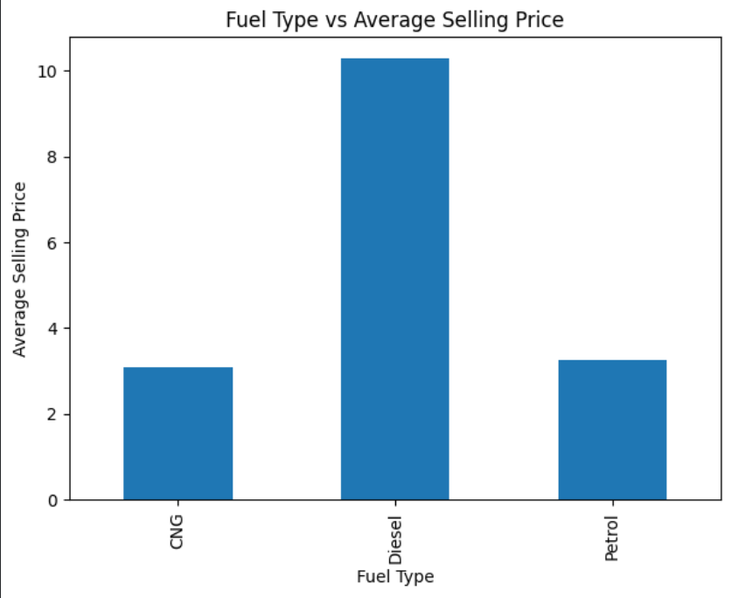

RESULTS
3. Fuel Type & Present Price
Fuel Type Breakdown
Fuel Type | Avg. Present Price | Sample
Diesel | ₹10.28L | —
Petrol | ₹3.26L | —
CNG | ₹3.10L | n=2
Observation
Diesel vehicles exhibit significantly higher present prices than Petrol or CNG vehicles in this dataset. Present Price is an important variable for contextualizing Selling Price comparisons across fuel types.
CNG: only 2 observations. Do not generalize CNG findings beyond this dataset.
Demo Link : Click Here

Slide 9
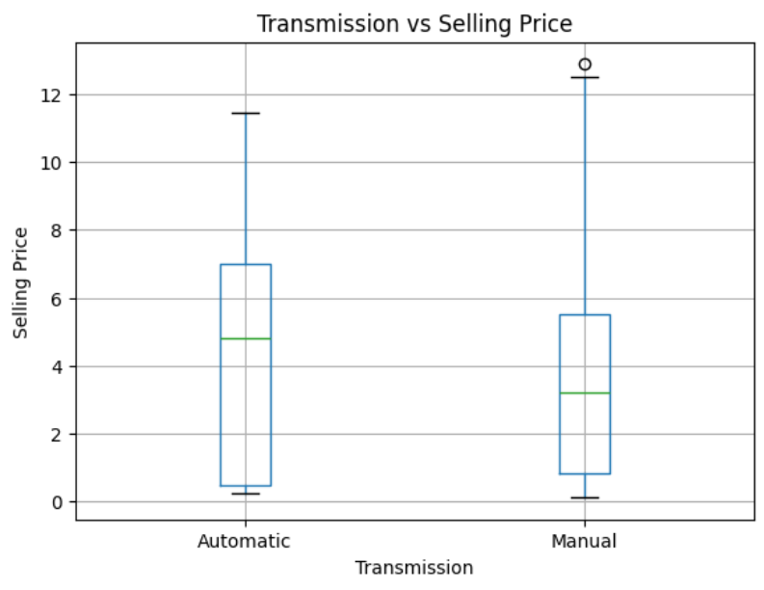

RESULTS
4. Transmission Type vs. Selling Price
Findings (Post-Outlier Cleaning)
Type | Avg. Selling Price | Count (n)
Automatic | ₹4.3291L | 22
Manual | ₹3.7052L | 254
Interpretation & Limitation
Automatic vehicles show a higher average selling price (₹4.33L vs ₹3.71L). However, Manual vehicles dominate the dataset at 254 records versus only 22 Automatic records.
The small Automatic sample (n=22) limits the generalizability of this comparison. The observed difference may not hold in a more balanced dataset.
Demo Link : Click Here

Slide 10
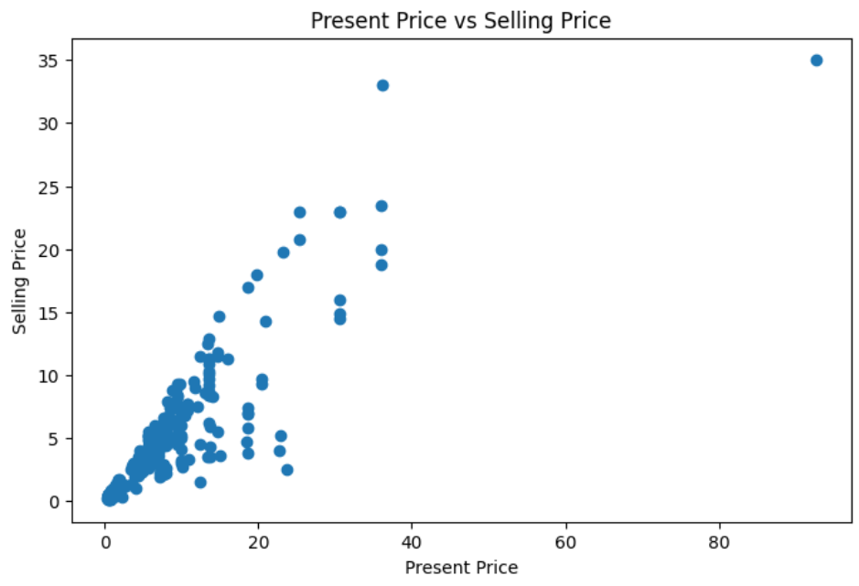
RESULTS
5. Present Price vs. Selling Price
Key Insights
The scatter plot helps identify the relationship and trend between Present Price and Selling Price in the dataset.
Examine whether cars with higher present prices tend to have higher selling prices.
Visual analysis of the distribution and correlation pattern between these two variables would provide insights into how a car's current market value influences its resale value.
This analysis focuses on the visual relationship. No specific numerical correlation or causal claims are made without supporting data.
The scatter plot above would display individual car data points to visualize the relationship between Present Price and Selling Price.
Demo Link : Click Here

Slide 11

.
.

